Slide 1
1- How each movement is recognized? 2- Does ANNs distinguish different movements in a similar way as we do ? 2- How NN understand movement? 3- Is it inspired by motor control? Of course not?
How can we improve these models for healthcare application?
Can we classify abnormality in movements?

Slide 2
Ways to approach the goals?
Normal/abnormal pattern?
Movements characteristics/identifier
How NN process this task??

Slide 3
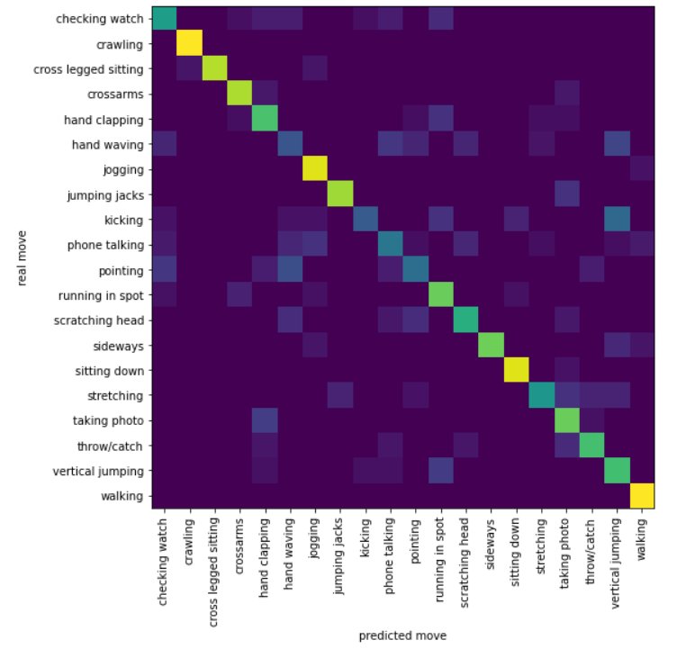
Model
2 Conv1d
3 fully connected layers
70 subject
20 class
80% acc (test)

Slide 4
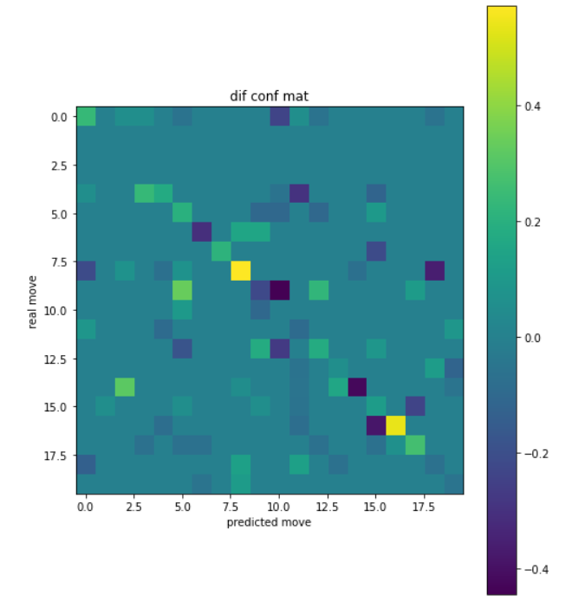
Methods for make equal time series
for the model
Padding or interpolation or

Slide 5
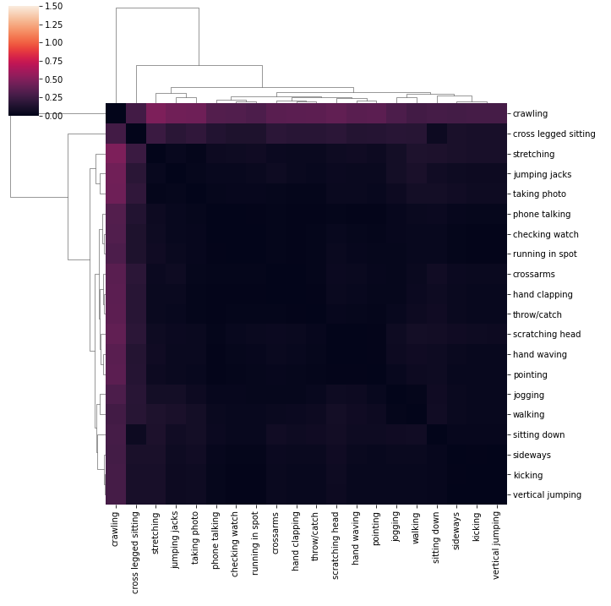
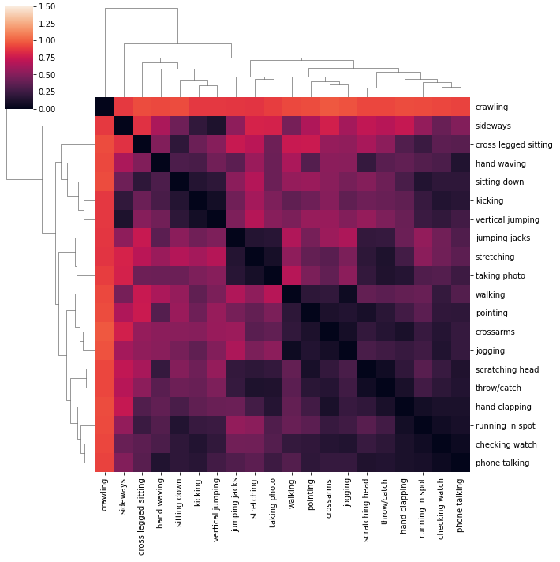

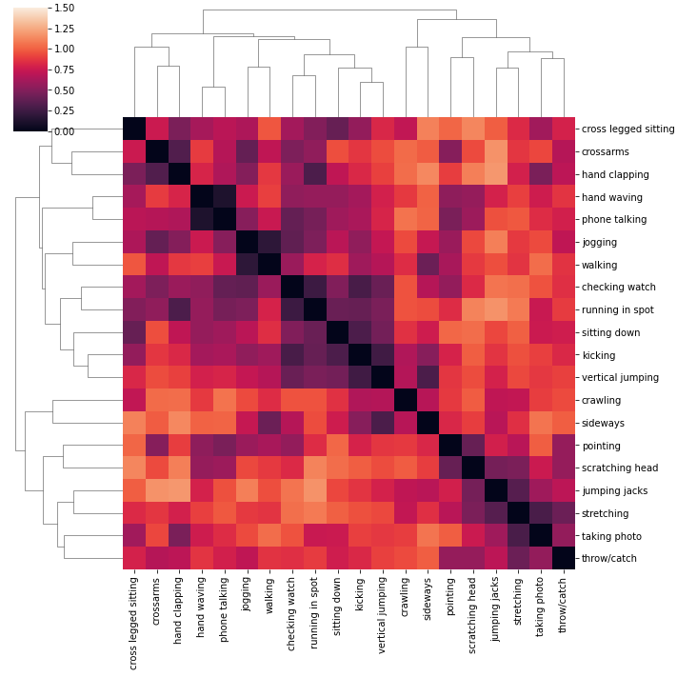
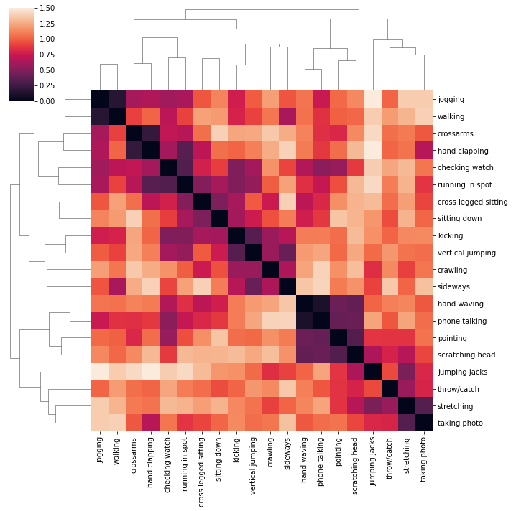
RDM
the dissimilarity between two patterns as 1−r based on the pearson correlation between the patterns r, i.e.:

Slide 6
PCA for each layer output to see any finding pointing to process of classification
TSNE clustering for all layers

Slide 7
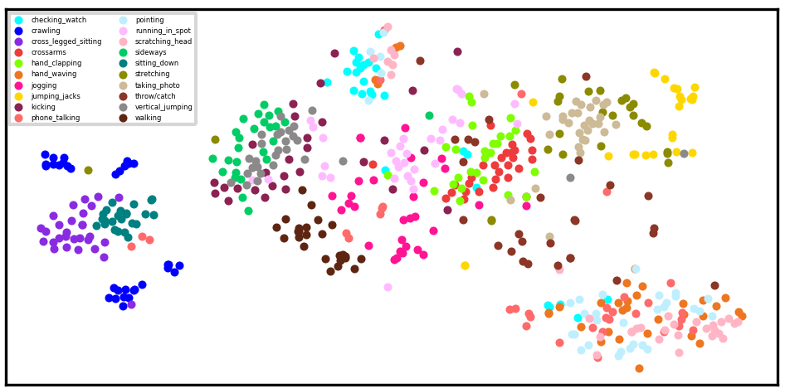
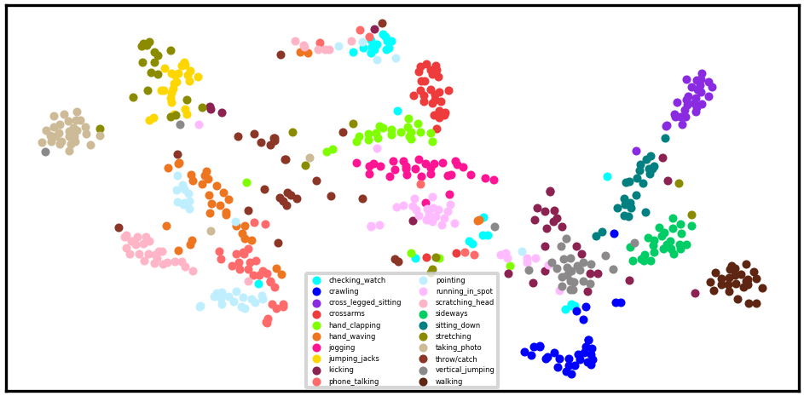
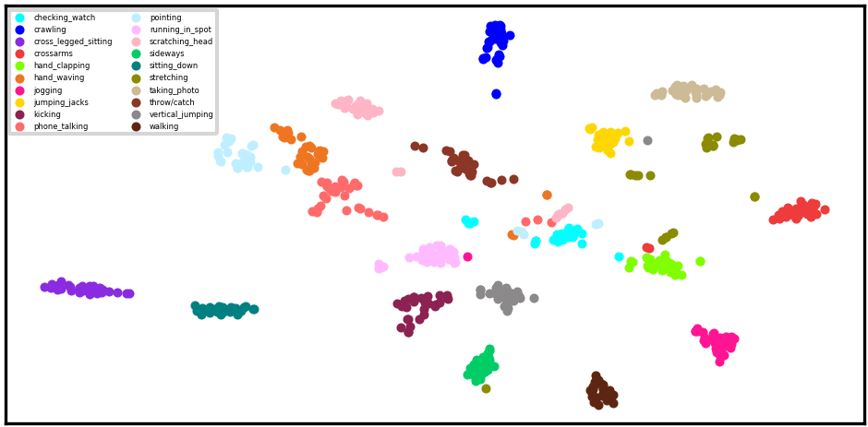
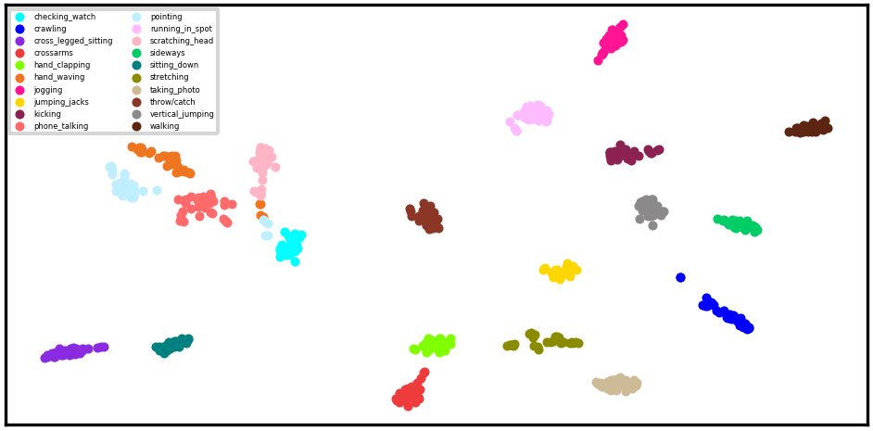
Tsne Training

Slide 8
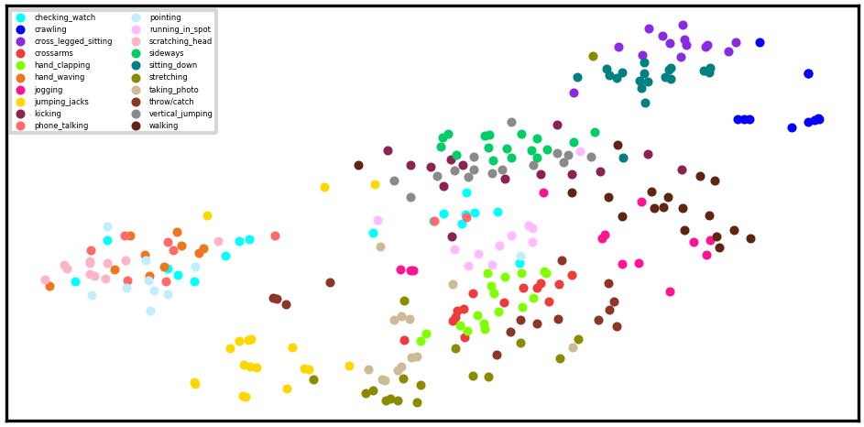
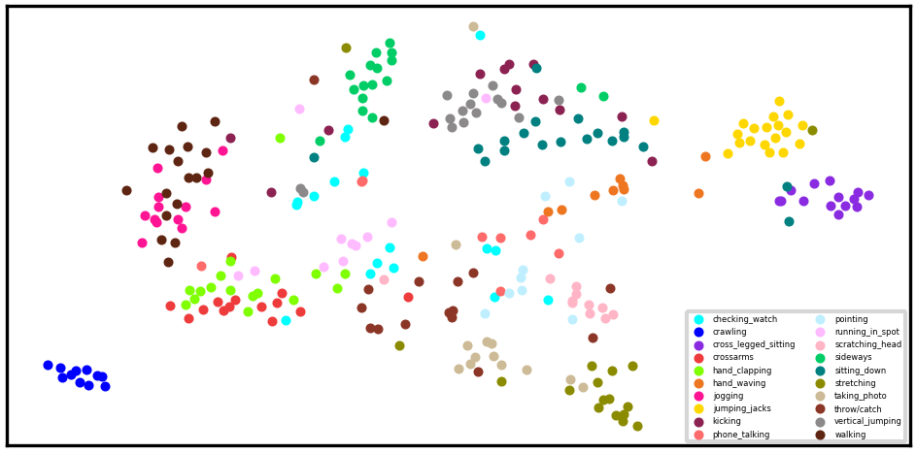
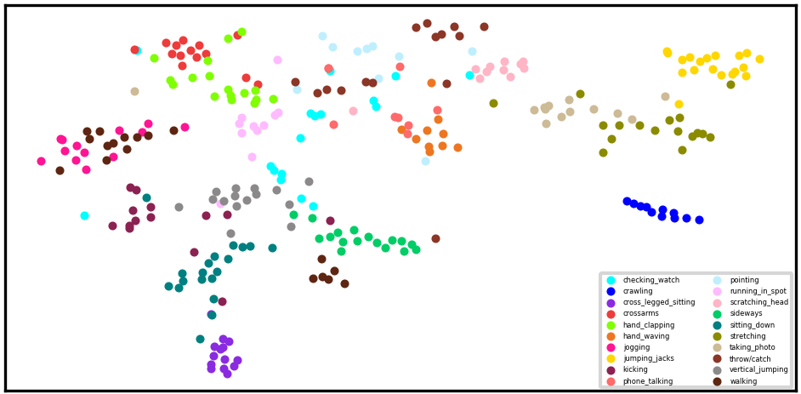
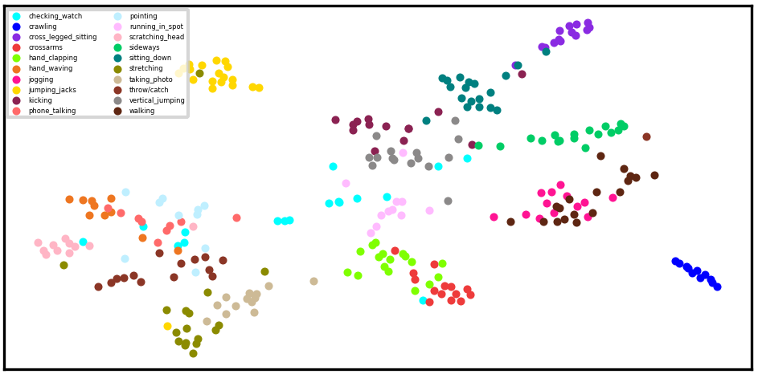
Tsne Test

Slide 9
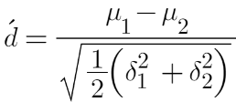
Frequency-based perturbation d-prime
How does one specific freq differ the classification result?
How can we interpret TSNE results?
In each freq on specific joint, calculating d-prime between each two categories

Slide 10
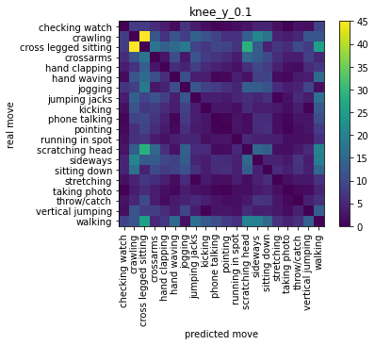
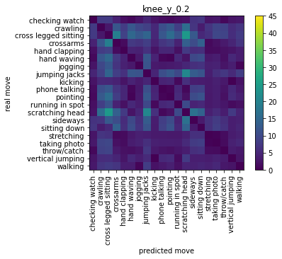
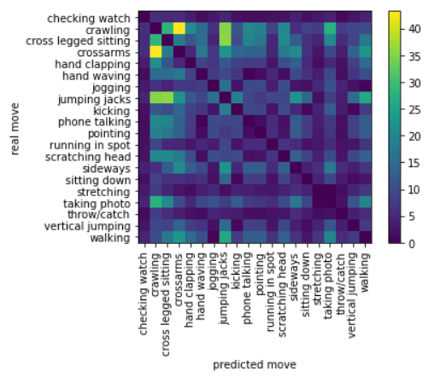
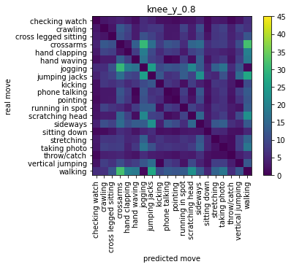

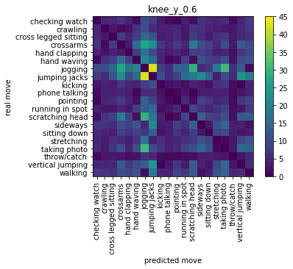

Slide 11
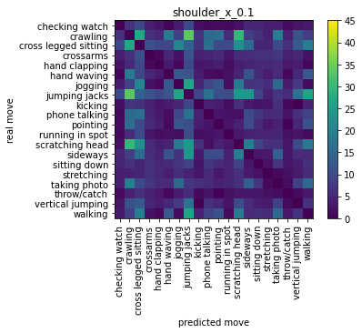
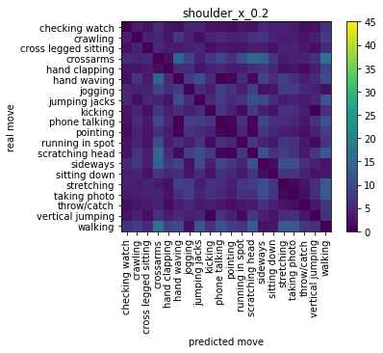
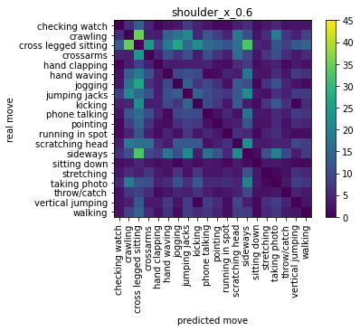
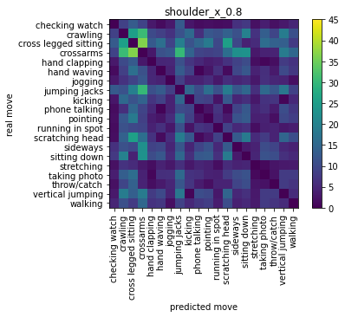
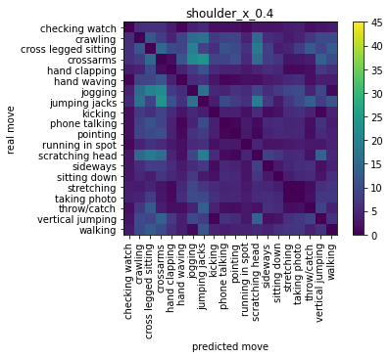

Slide 12
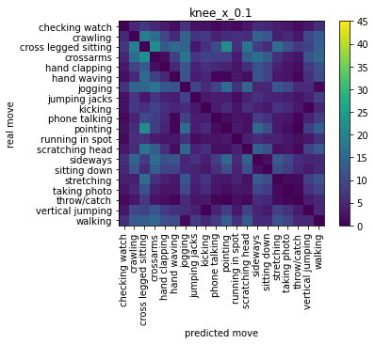
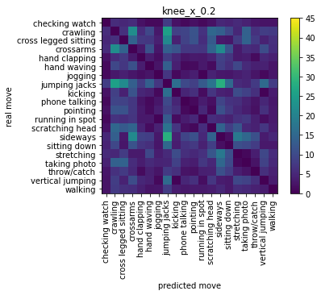

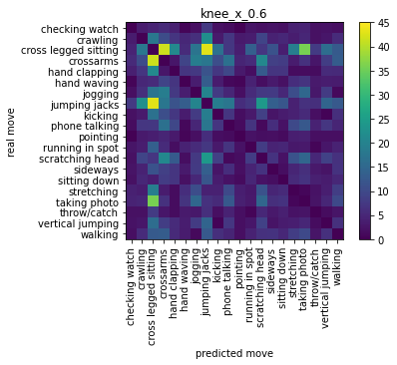
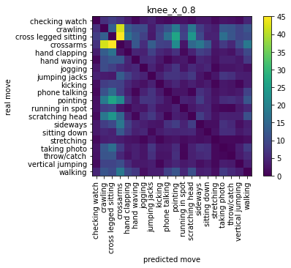

Slide 13
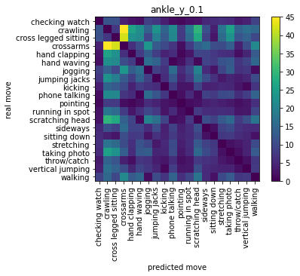

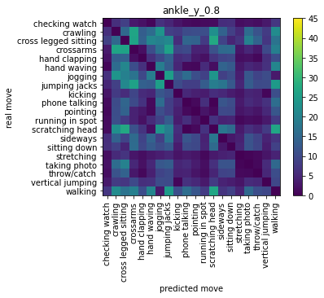



Slide 14
Animations Analysis
Does the model fool or comprehend the movements as humans do?
Variables:
Amplitudes
Frequency
Joints
two class “walking” & “jumping jacks”:, perturb one specific joint
Freq
 | 0.2 | 0.5 | 0.8
20 | 100 | 100 | 100
30 | 100 | 100 | 100
80 | 100 | 100 | 100
amp

Slide 15
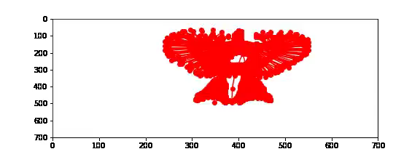
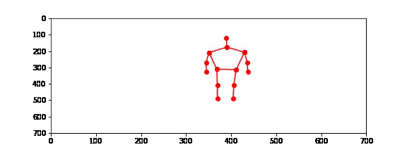
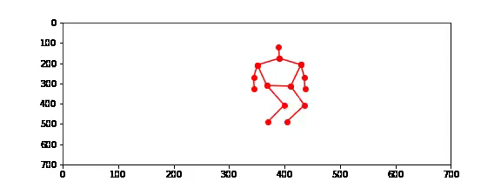

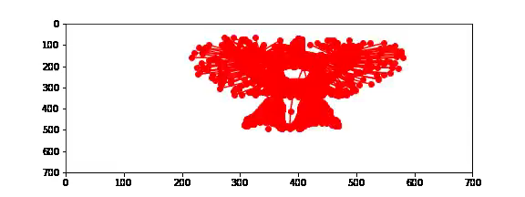
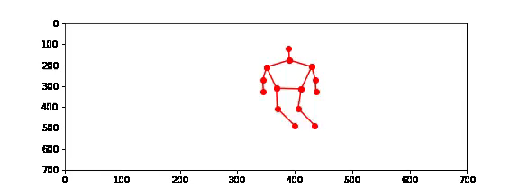

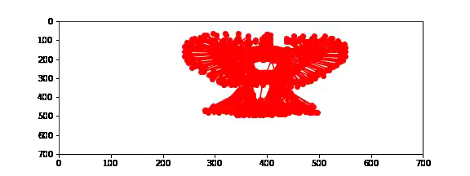
Animations Analysis

Slide 16
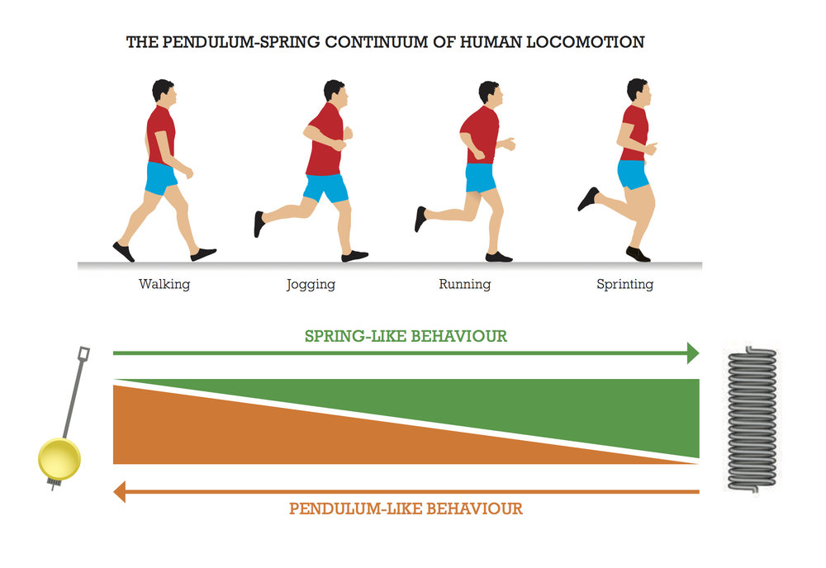
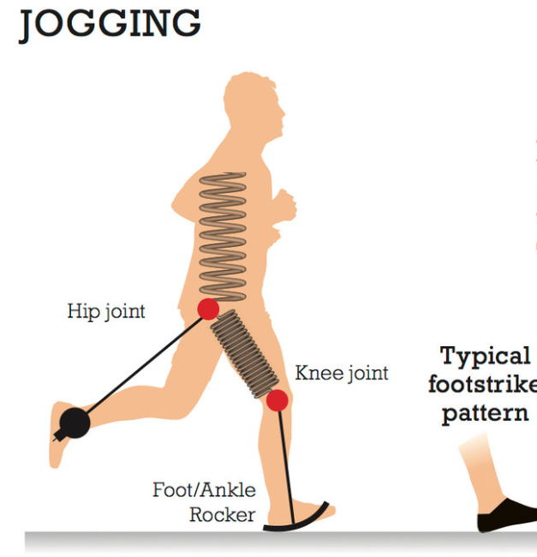
When jogging, the knee and hip act like ‘springs’ as in running, but the foot and ankle act as ‘rockers’ with the same heel-toe pattern as walking.
The forces acting on the leg during the support phase double from 120% bodyweight when walking to over 250% bodyweight when jogging.
The range of movement required at the ankle also increases from a minimum of 10 degrees dorsiflexion when walking to a minimum 20 degrees dorsiflexion when jogging.
Skillful human movement is characterised by adopting the locomotive strategy for a given speed and terrain that maximises economy while minimising injury risk.
These locomotive strategies become progressively less pendulum like and more spring like as speed and gravitational loading increase and contact time decreases

Slide 17
To Do?
Focus on subdivided movements
Try multiclass model for animation analysis
Try multi joint perturbation

